Slide 1
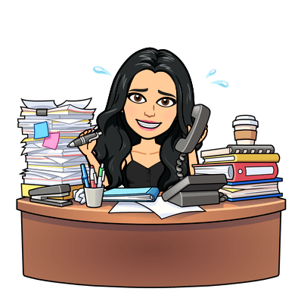
Please log on to Microsoft Teams daily during your scheduled class period for live lessons, assignments, and announcements.

