Slide 1
How to Access OFFICE 365 from CLEVER

Slide 2
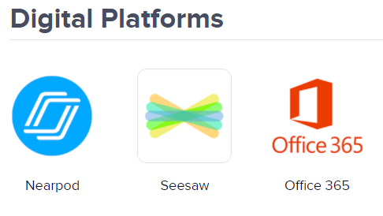
Log in using the following information:
CLEVER –www.clever.com/in/yonkers
Scroll to Digital platforms
Click on OFFICE 365
Username: 6digit@yonkerspublicschools.org
Password: district password you normally use to log in
Click

Slide 3
There are many APPS located in the OFFICE 365 Suite.

Slide 4
Outlook is where your email is located.

Slide 5
Here you can create a WORD DOCUMENT, work on a POWERPOINT or join TEAMS. Plus so many other options!

Slide 6
ENJOY USING THE OFFICE 365 SUITE!
created by Mrs. Levy​

