Slide 1
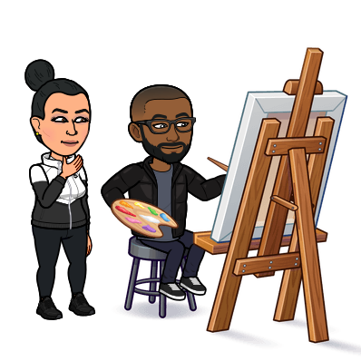
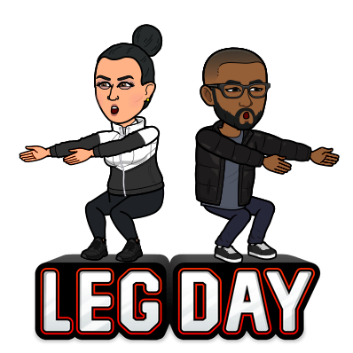
Our Specials
Monday – Art
Tuesday – Literacy in the Science Lab
Wednesday – Technology
Thursday – Technology
Friday – Gym

