Slide 1
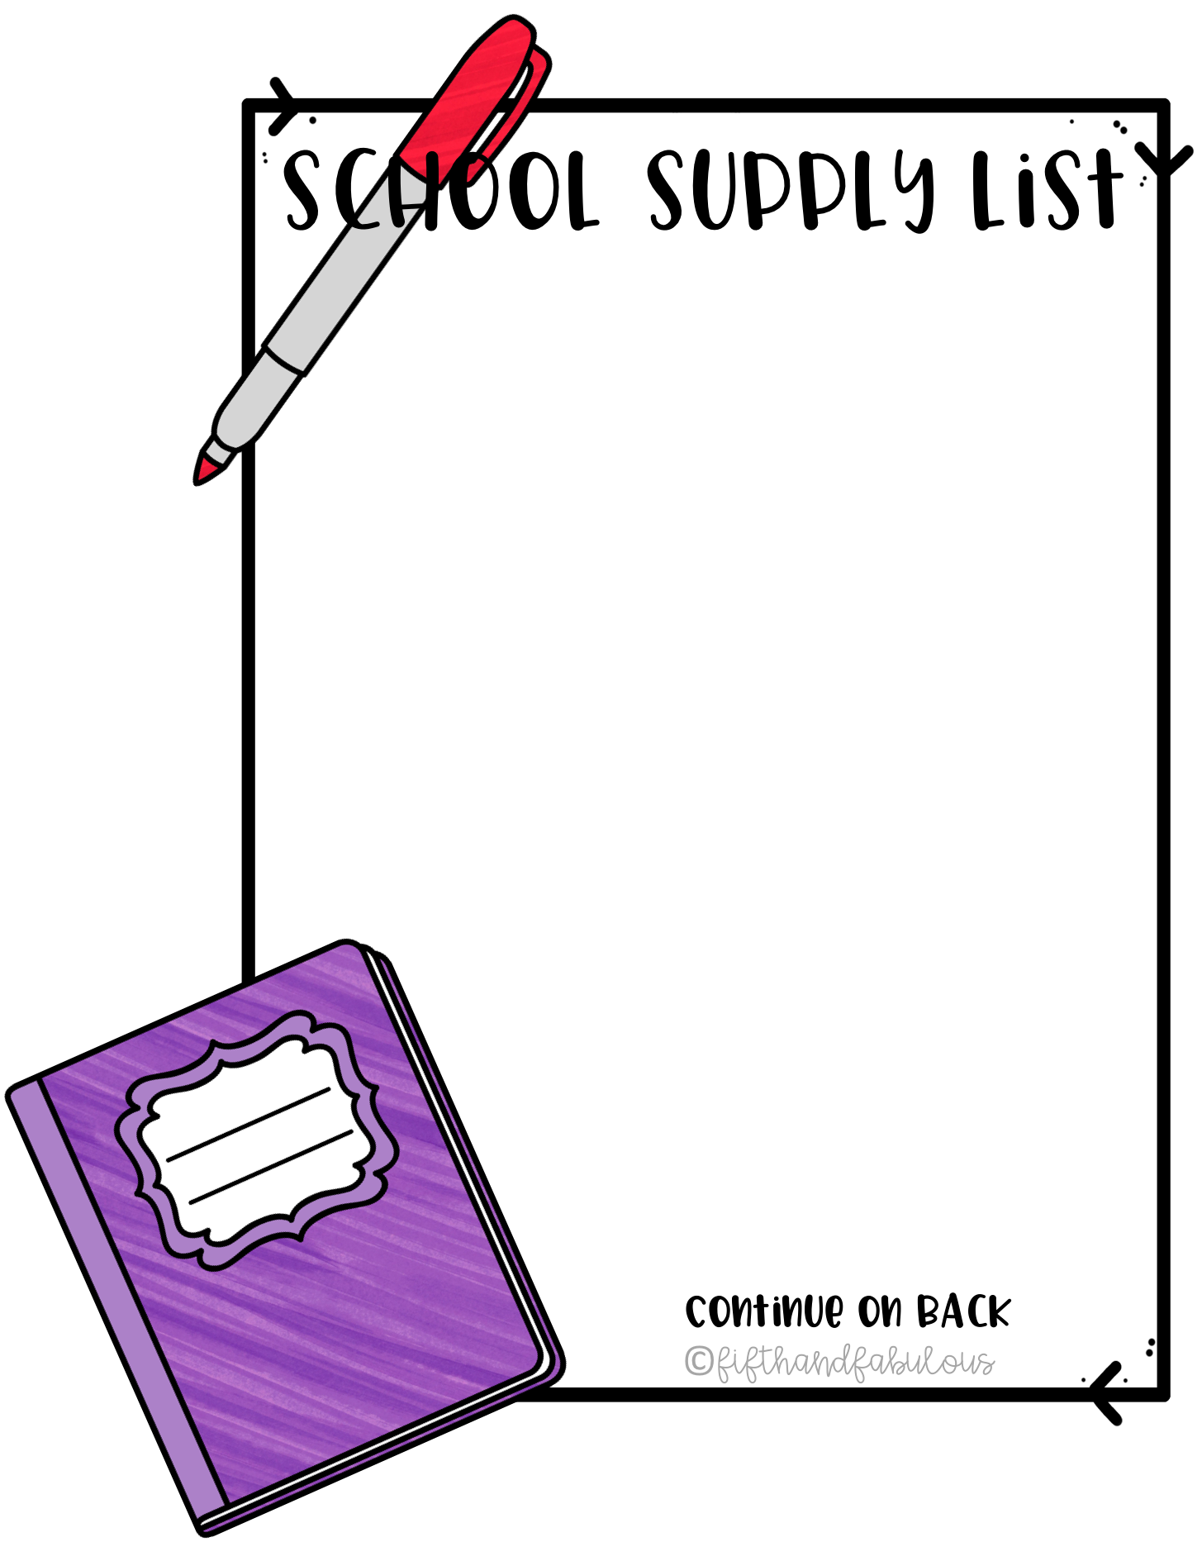
PreKindergarten
2 PRIMARY ruled notebooks/2 cuadernos blanco negro de composicion primario
1 box JUMBO crayons/1 cajas de crayolas gigantes
2 boxes regular crayons/2 cajas de crayolas regulares
1 pack thick washable markers/1 caja de marcadores gruesos lavables
4 Glue sticks/4 barras de pegamento
Hand sanitizer/1 botellla de gel antibacterial para uso en agua
2 Large Clorox disinfecting wipes/2 cajas de toallas humedas clorox
2 boxes JUMBO pencils/2 cajas de lapices gigantes
2 boxes tissues/2 cajas de tissue(panuelos de papel)
1 roll paper towels/1 rollo de papel de toallas
1 8x5 plastic pencil box/1 caja para utiles(lapices,borradores etc.)
5 PLASTIC two pocket folders/5 cartapcios de bosillos plasticos.
1 pair safety scissors/1 tijeras de punta redonda.
1 large backpack PLEASE be sure it is large enough to hold folders and lunch boxes/1 mochila tamano grande​
Compete change of clothing including socks to keep on hand in case of accidents/1 cambio total de ropa incluyendo medias ​
1 large (gallon) and 1 small (quart) box of zip lock bags/1cajas ziploc, una tamano​ galon y una tamano de cuarto
Yonkers Public Schools

