Slide 1
Perfect Competition
In this lesson, students will identify characteristics of perfectly competitive markets.
Students will be able to identify and/or define the following terms:
Perfect Competition
Commodities
Barriers to Entry

Slide 2
Do Now
What is competition in business?

Slide 3
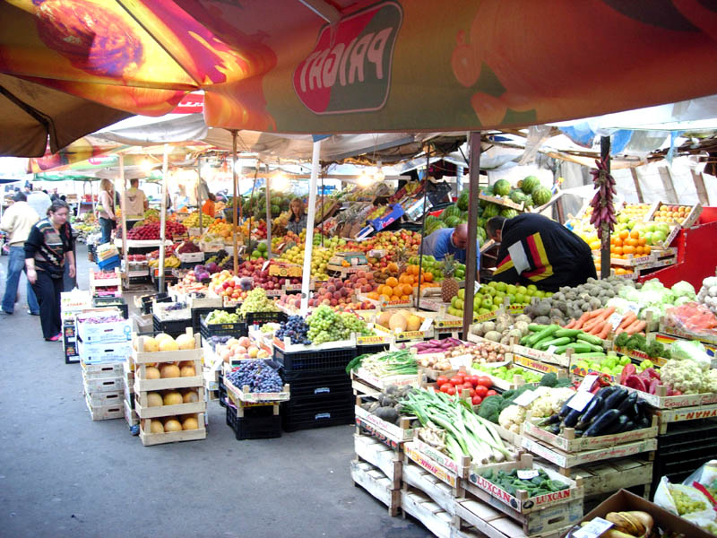
A market is any venue where buyers and sellers meet.

Slide 4
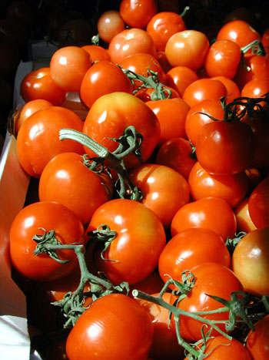
In a perfectly competitive market, a large number of firms produce the same product.

Slide 5
Perfect Competition
A perfectly competitive market has four conditions:
There are many buyers and sellers.
Sellers offer identical products.
Buyers and sellers are well-informed about their products.
Sellers are able to enter and exit the market freely.

Slide 6
Perfect Competition
Perfect competition is a market structure in which a large number of firms all produce the same product.
In a perfectly competitive market, price and output reach their equilibrium levels.

Slide 7
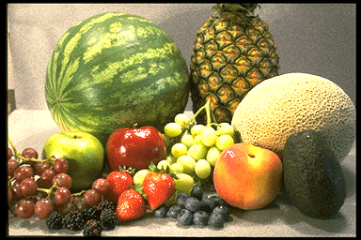
Markets for fruits and vegetables are usually perfectly competitive markets.

Slide 8
Commodities
Commodities are generally sold in perfectly competitive markets.
A commodity is a product that is the same no matter who produces it.
Milk, petroleum, and apples are examples of commodities.

Slide 9
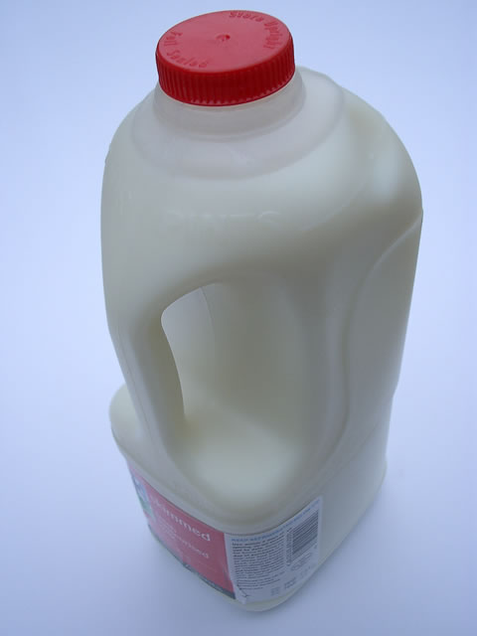
Milk is milk.
It is exactly the same regardless of who sells it.

Slide 10
Barrier to Entry
A barrier to entry is any condition that makes it difficult to enter a market.
High start-up costs are barriers to entry.
A great degree of technical knowledge can also be a barrier to entry.

Slide 11
If opening a new business requires hundreds of thousands of dollars, that high start-up cost is a barrier to entry.

Slide 12
Needing a tremendous amount of technical knowledge is another example of a barrier to entry.

Slide 13
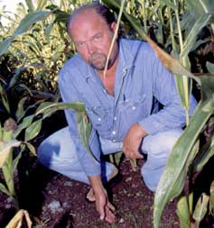
Growing corn doesn’t require a tremendous amount of money or knowledge.

Slide 14
Opening a commercial airline industry requires a tremendous amount of capital.

Slide 15
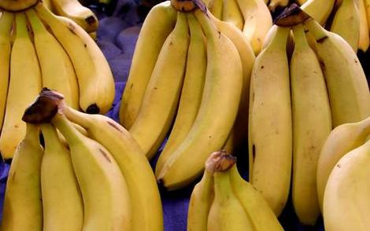
Few markets are perfectly competitive.
Products must be identical in a perfectly competitive market.

Slide 16
Barriers to entry can lead to imperfect competition.

Slide 17
Questions for Reflection:
List the four conditions of perfect competition.
Define commodity and provide an example of a commodity.
What is a barrier to entry?
Provide two examples of barriers to entry and explain why they are barriers to entry.
Why are few markets perfectly competitive?

