Slide 1
The World in 1750
Unit 10.01

Slide 2
How do empires consolidate their power? How do these empires respond to increased diversity and interconnectedness?
Unit
Essential
Questions:

Slide 3
Unit Description
The world in 1750 was marked by powerful Eurasian states and empires, coastal African kingdoms, and growing European maritime empires. The interactions of these states, empires, and kingdoms disrupted regional trade networks and influenced the development of new global trade networks.

Slide 4
Conceptual Understandings (NYS Social Studies Framework Alignment)
NYS Key Ideas 10.1 THE WORLD in 1750: The world in 1750 was marked by powerful Eurasian states and empires, coastal African kingdoms, and growing European maritime empires. The interactions of these states, empires, and kingdoms disrupted regional trade networks and influenced the development of new global trade networks. (Standards: 2, 3, 5; Themes: ID, GEO, GOV, EXCH)
NYS Conceptual Understandings Students will know … | NYS Content Specifications Students will be able to …
10.1a Powerful Eurasian states and empires faced and responded to challenges ca. 1750. | compare and contrast the Mughal Empire and the Ottoman Empire in 1750 in terms of religious and ethnic tolerance, political organization, and commercial activity examine efforts to unify, stabilize, and centralize Japan under the rule of the Tokugawa Shogunate compare and contrast the Tokugawa Shogunate in Japan with France under the rule of the Bourbon Dynasty, looking at the role of Edo and Paris/Versailles, attempts to control the daimyo and nobles, and the development of bureaucracies.
 | create a world map showing the extent of European maritime empires, the Russian Empire, the Ottoman Empire, Mughal Empire, China under the Qing Dynasty, Japan under the Tokugawa Shogunate, Ashanti, Benin, and Dahomey ca. 1750 compare the size of these states, empires, and kingdoms relative to the power they wielded in their regions and in the world

Slide 5
ACTIVITIES & ASSIGNMENTS FOR THE UNIT
VOCABULARY OPENER
CHROLOLOGICAL THINKING AND GRAPHIC CONTEXT – The World in 1750 Activity
CONTEXTUALIZE AND CONNECT CAUSE AND EFFECT-EUROPEAN INFLUENCE IN ASIA CLAIM PARAGRAPH
MASTERING THE GRADE 10 GLOBAL HISTORY CURRICULUM - Chapter 5 – The World in 1750 (pgs 33-55)
CLOSE READ ACTIVITY (two reads)
CONCEPT MAPS
Ottoman Empire in ca. 1750
Mughal Empire ca. 1750
Tokugawa Shogunate ca. 1750

Slide 6
DAY 1 -
PASS OUT VOCABULARY OPENER
CHROLOLOGICAL THINKING AND GRAPHIC CONTEXT – The World in 1750 Cause and Effect Chain Activity
SHOW PPT INSTRUCTIONS

Slide 7
Read the prompt and as a group, predict possible answers by brainstorming. Jot down your ideas under the prompt.

Slide 8
The Crusades Spark Interest in Goods from Asia

Slide 9
Marco Polo’s Book About His Adventures in Asia and the Mongol Empire Are Popular in Europe

Slide 10
Trade Between Italy and the Ottoman Empire Increased

Slide 11
Middle Eastern Merchants Raise Prices on Good from Asia Enroute to Europe to Make a Profit

Slide 15
Mughal, Ottoman, and Tokugawa Empires
Students will compare and contrast the Mughal Empire and the Ottoman Empire in 1750 in terms of religious and ethnic tolerance, political organization, and commercial activity, explore the methods used by the Tokugawa Shogunate to gain, consolidate, and maintain power, and examine the reactions of the Mughal Empire and Tokugawa Shogunate to European "outsiders."

Slide 16
Territorial Evolution of the Ottoman Empire

Slide 17
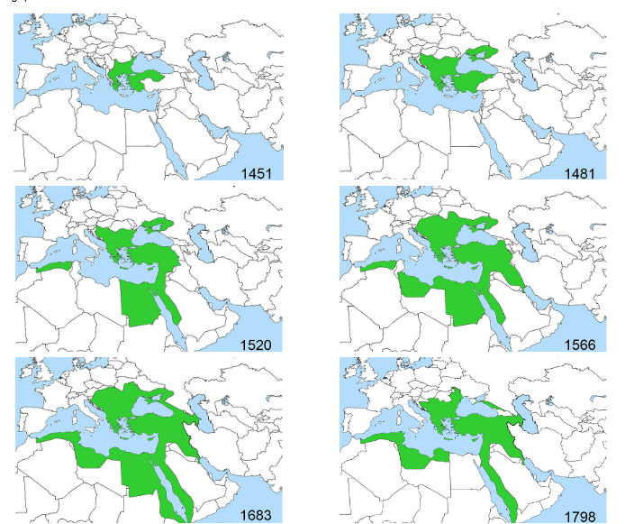
Territorial Evolution of the Ottoman Empire
1. Using the maps above and video, describe how the extent of the Ottoman Empire changed from the 15th century to the 18th century.
2. At the height of its power in the late 16th to early 17th centuries, to which three continents did the Ottoman Empire expand?
3. Make a Prediction: How might leaders of the Ottoman Empire have gained, maintained, and consolidated power?

Slide 18
Ottoman Empire: Gaining, Consolidating, and Maintaining Power in a Diverse Empire
The Ottoman Empire was a Muslim Empire that ruled over parts of Asia, Africa, and Europe from 1299 until 1922. The Ottomans were Turkish-speaking nomadic people who migrated from Central Asia in northwestern Asia Minor. They quickly conquered other societies and expanded their empire, establishing a society organized around Islam and Islamic institutions. As the Ottoman Empire grew, non-Muslim people became part of it. The Ottoman Empire was diverse and composed of three major religious groups that contained many different ethnic groups. The major religious groups were three monotheistic Abrahamic religions: Islam, Christianity, and Judaism. The Ottoman Empire developed strategies to govern their diverse empire.

Slide 19
Millets
In the Ottoman Empire, non-Muslims were not required to convert to Islam. Instead, the Ottoman Empire developed millets. Millets were self-governing non-Muslim (Jewish and Christian) communities within the Ottoman Empire that had the power to regulate their own communities, collect taxes, set up their own schools, and organize their own laws. The millets were run by a religious leader who was responsible for maintaining peace within the millet. In return for religious freedom, non-Muslims within the millets owed absolute loyalty to the Ottoman Empire. Additionally, non-Muslims were barred from high government positions in the Ottoman Empire.

Slide 20
Devshirme System
Beginning in the 14th century and ending in the late 17th century, the Ottoman Empire created a system called the Devshirme system. The Devshirme system required conquered Christian communities to give their sons to the Ottoman government as a form of tax. These Christian boys were forced to convert to Islam and served as state slaves. Some of the young Christian boys trained to work in the government. They had to take a series of exams to identify their skills and they also took special classes in languages, math, calligraphy, Islamic studies, and weaponry. These Christian boys owed the sultan complete loyalty and gained positions as guards, scribes, and gatekeepers. This proximity to the sultan helped the devshirme gain some wealth and power; however, their children were not allowed to inherit their wealth. Other Devshirme served in the military corps, the Janissaries. These Janissaries, who were mostly forced Muslim converts, helped the Ottoman Empire to expand its territory.

Slide 21
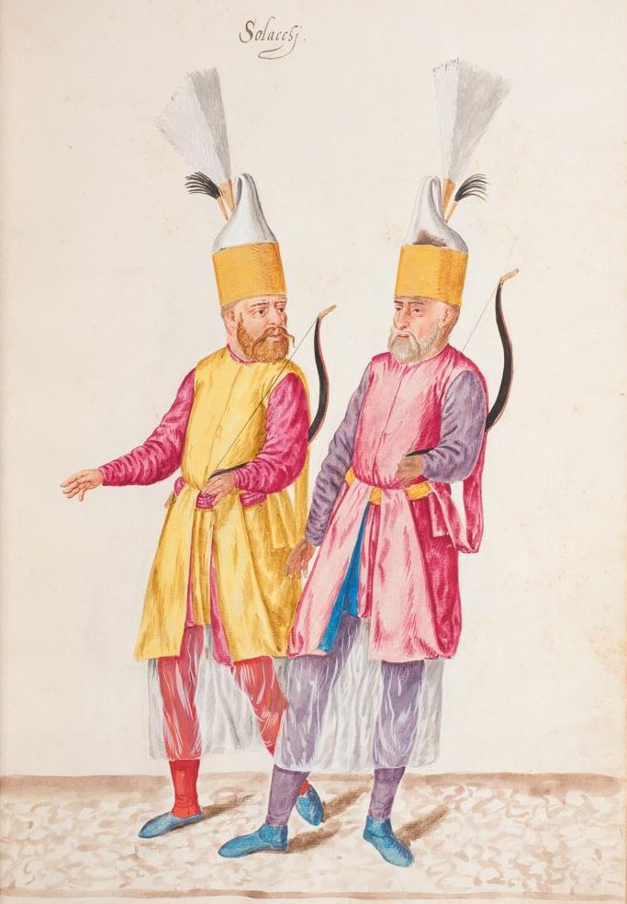
Janissaries
The Janissaries were the elite army of the Ottoman Empire until 1826. The Ottoman Empire used Janissaries in all its military conquests such as the 1453 capture of Constantinople. The janissaries were mostly made up of young Christian boys from the Devshirme system. The owed complete loyalty to the sultan and were required to follow strict rules such as celibacy and no marriage until they left active duty.

Slide 23
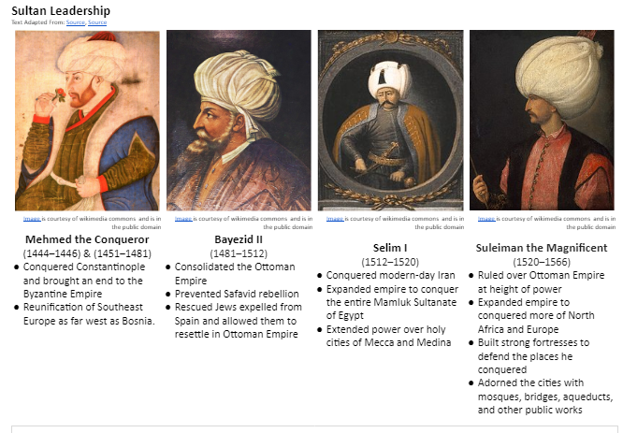

Slide 24
Territorial Evolution of the Mughal Empire

Slide 25
Mughal Empire: Gaining, Consolidating, and Maintaining Power in a Diverse Empire
The Mughal empire was a Muslim dynasty that ruled parts of modern-day India and Pakistan from 1526 to 1857. The Mughal Empire was of Turkic-Mongol, or Central Asian origin. The Mughal Empire conquered areas that included two major religious groups: Hindus and Muslims.

Slide 27
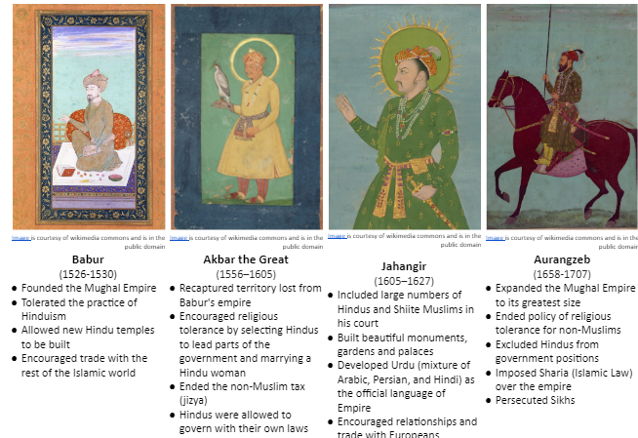
Mughal Empire:

Slide 28
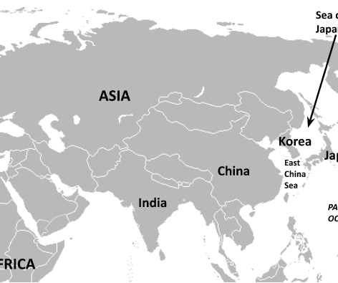
SQ 2. How did the Tokugawa Shogunate gain, consolidate, and maintain power in Japan?

Slide 29
“Geography of Japan” by Mr. Zoller (5:53)

Slide 30
“Japan’s Geographic Challenge” from Stratfor (2:00)

Slide 31
Geographic Context of Japan
island (n.) | a body of land surrounded by water
archipelago (n.) | chain of islands
Irregular coastline (n.) | a coastline that is not smooth and usually has many natural harbors
population density (n.) | the number of people living in a given space
mountainous (adj.) | having many mountains

Slide 32
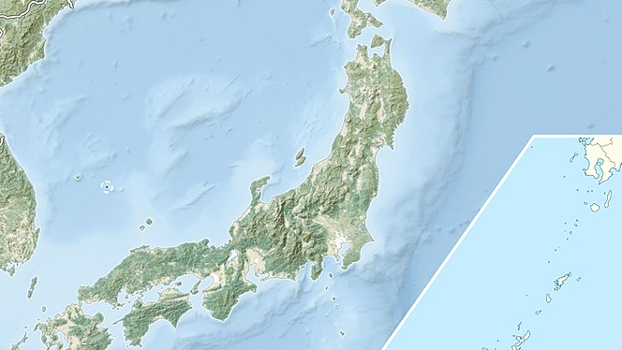
1. Japan is an archipelago, or a chain of islands. As a result...

Slide 33
2. Most of Japan is mountainous, therefore...

Slide 34
3. As an archipelago, Japan has an irregular coastline, which creates natural ports and harbors safe for ships to dock in, so...

Slide 35
4. Japan’s neighboring countries are Korea and China. As a result...

Slide 36
Historical Context: What was a shogunate? (6:18)

Slide 37
COMPLETE:
Mastering the Grade 10 Global History Curriculum Pages 33 - 43

Slide 38
SQ 3. What were the differences between how the Tokugawa Shogunate (1600-1868) and Mughal Empire (1526-1857) responded to “outsiders” in the 16th and early 17th centuries?
In 1453, the Ottoman Empire conquered Constantinople, leading them to dominate many overland trade routes that restricted the access of Europeans to Asia. In search of new access to Asia, many European societies, especially Spain and Portugal began overseas exploration and trade during the late 15th and early 16th centuries.

Slide 39
Contextualize: Japan and Relationships with “Outsiders”

Slide 40
Contextualize: Mughal Empire and Relationship with Europeans

Slide 41
Complete Mini-Close Read Activity (in pairs)

Slide 42
COMPLETE:
Mastering the Grade 10 Global History Curriculum Pages 44 – 57
Prepare for 10.01 test.
10.01 QUIZLET

