Slide 1
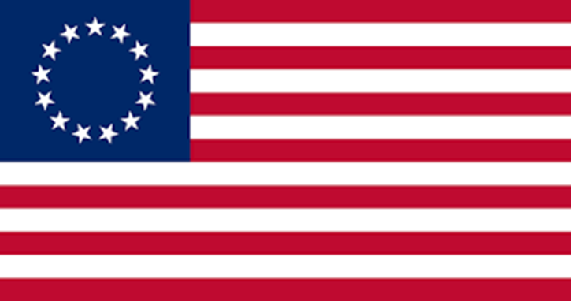
Colonial America (1607-1783)

Slide 2
Colonial America (1607-1783)
The period in American history in which European nations established colonies for raw materials, new markets, and global dominance only to later have colonists’ rebel and seek independence through an American Revolution.
Dependence to Independence
Monarchy to republic

Slide 3
Colonial America (1607-1783)
13 Colonies
Salutary Neglect (1607-1763)
French & Indian War (1754-1763)
Harmful Neglect (1763-1775)
American Revolution (1775-1783)

Slide 4
Colonial America (1607-1783)
North America has been a continent of many cultures that have sought to establish settlements. Each culture influenced its development.
Native Americans = Indigenous = Amerindians (Pre-history-1814)
New Spain (1492-1588)
New France (1608-1763)
New Netherlands (1624-1664)
British 13 Colonies (1607-1783)

Slide 5
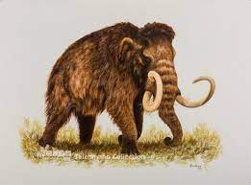
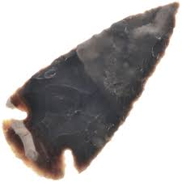
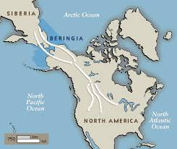
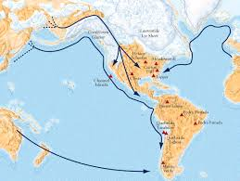
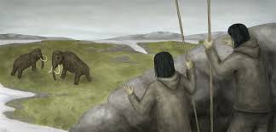
Native Americans
Native indigenous peoples crossed a land bridge around 12,000 BC during the last ice age called, “Beringia” that connected Asia to North America. Over thousands of years, thousands of Amerindians established paleolithic tribes across the Americas.

Slide 6
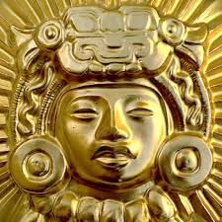
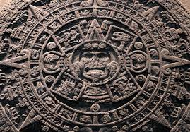
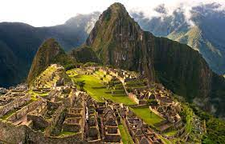
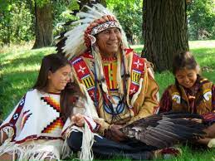
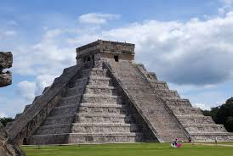
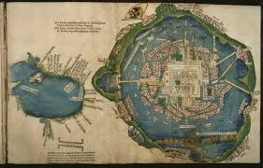
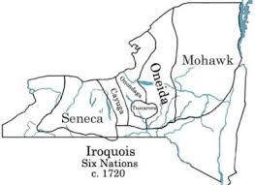
Native Americans
Thousands of native indigenous tribes settled the Americas and lived based on the geographic features of the lands. Some of these tribes included:
Aztecs
Mayans
Incas
Iroquois
Hurons
Arawaks
Tainos

Slide 7
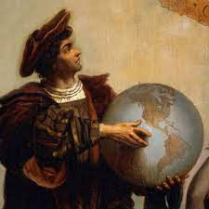
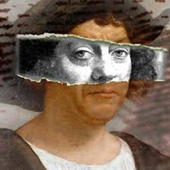
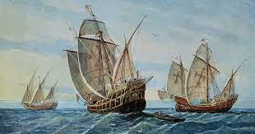
The Rise of Europe
In the midst of the Renaissance in 1492, Columbus sailed the ocean blue looking for a route to India and China to trade in sugar, silk, and spices. In doing so, he “discovered” the “New World” from a European perspective on October 12, 1492 making landfall in the Bahamas. He named the island “San Salvador.” Although not the first to discover the Americas, his voyage would lead many more Europeans to voyage across the Atlantic looking for resources and trade, which led to the development of the Columbian Exchange, colonization of the Americas, and the end of free indigenous tribes.

Slide 8
The Encounter October 12, 1492

Slide 9
Imperialism
With Columbus’s voyage to the new world, Europe would begin a policy known as imperialism, which is the domination of one country over another for social, political, or economic control. This policy would develop into a rivalry between the major powers of Europe.
Imperialism = Colonialism = Mercantilism
Colonialism is the establishment of territories for raw materials and new markets.
Mercantilism is an economic system of trade between Mother Country and it’s colonies.

Slide 10
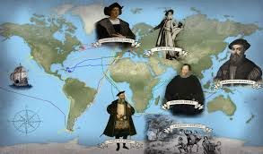
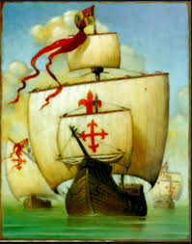
Imperialism

Slide 11
Colonization of the New World
Christopher Columbus sails for Spain (1492)
Amerigo Vespucci sails for Spain (1499)
Vasco da Gama sails for Portugal (1497)
Giovanni da Verrazano sails for France (1534)
Hendrick Hudson for the Netherlands (1610)
Ferdinand Magellan for Spain (1521)

Slide 12
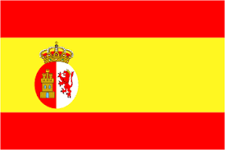
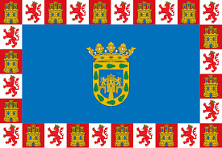
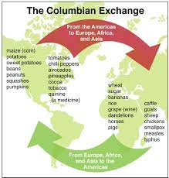
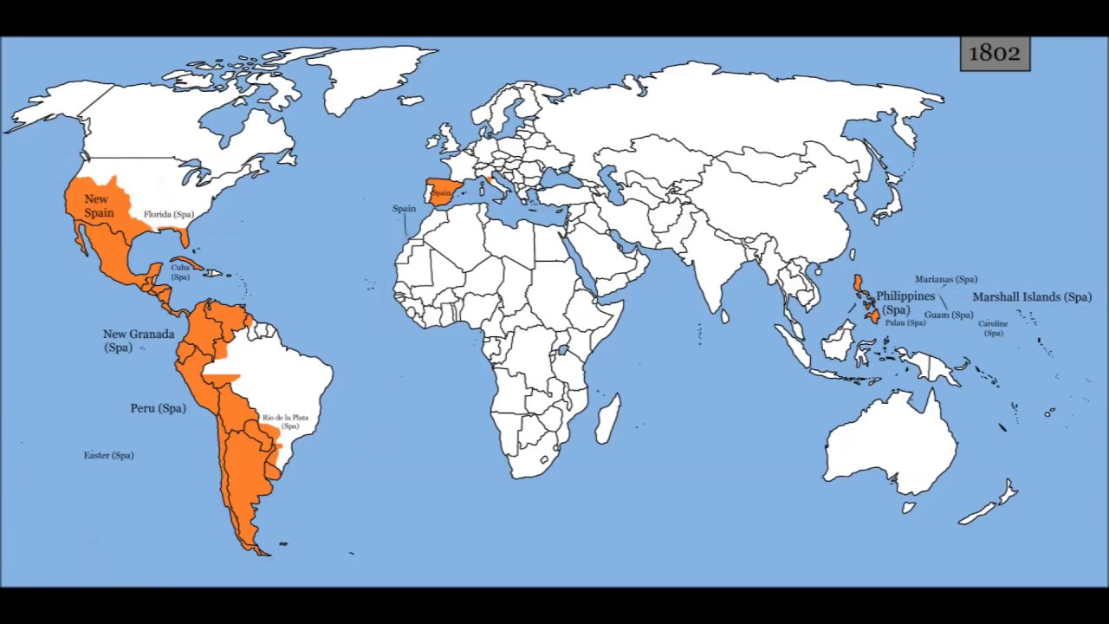
New Spain 1535-1821
Spain dominated the Americas conquering the native indigenous peoples, establishing colonies, and seeking God, Gold, and Glory for its monarchs. Along with Portugal, African slavery will be introduced to the New World.

Slide 13
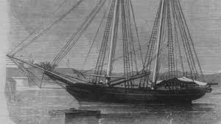
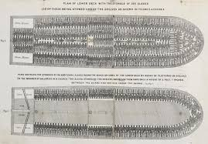
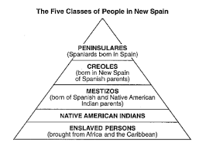
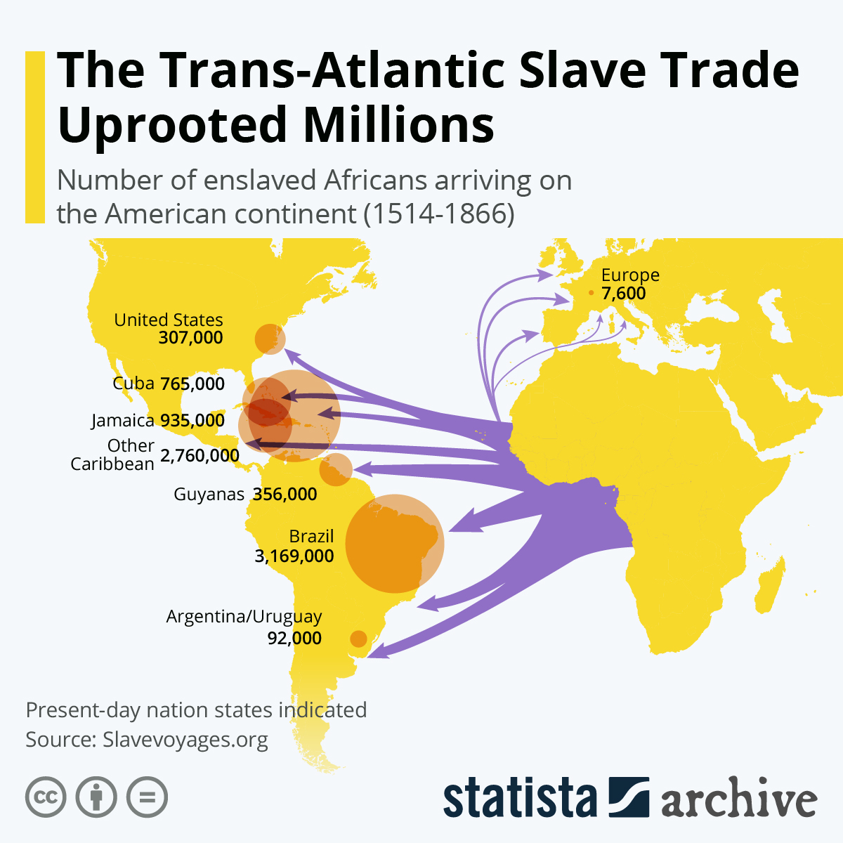
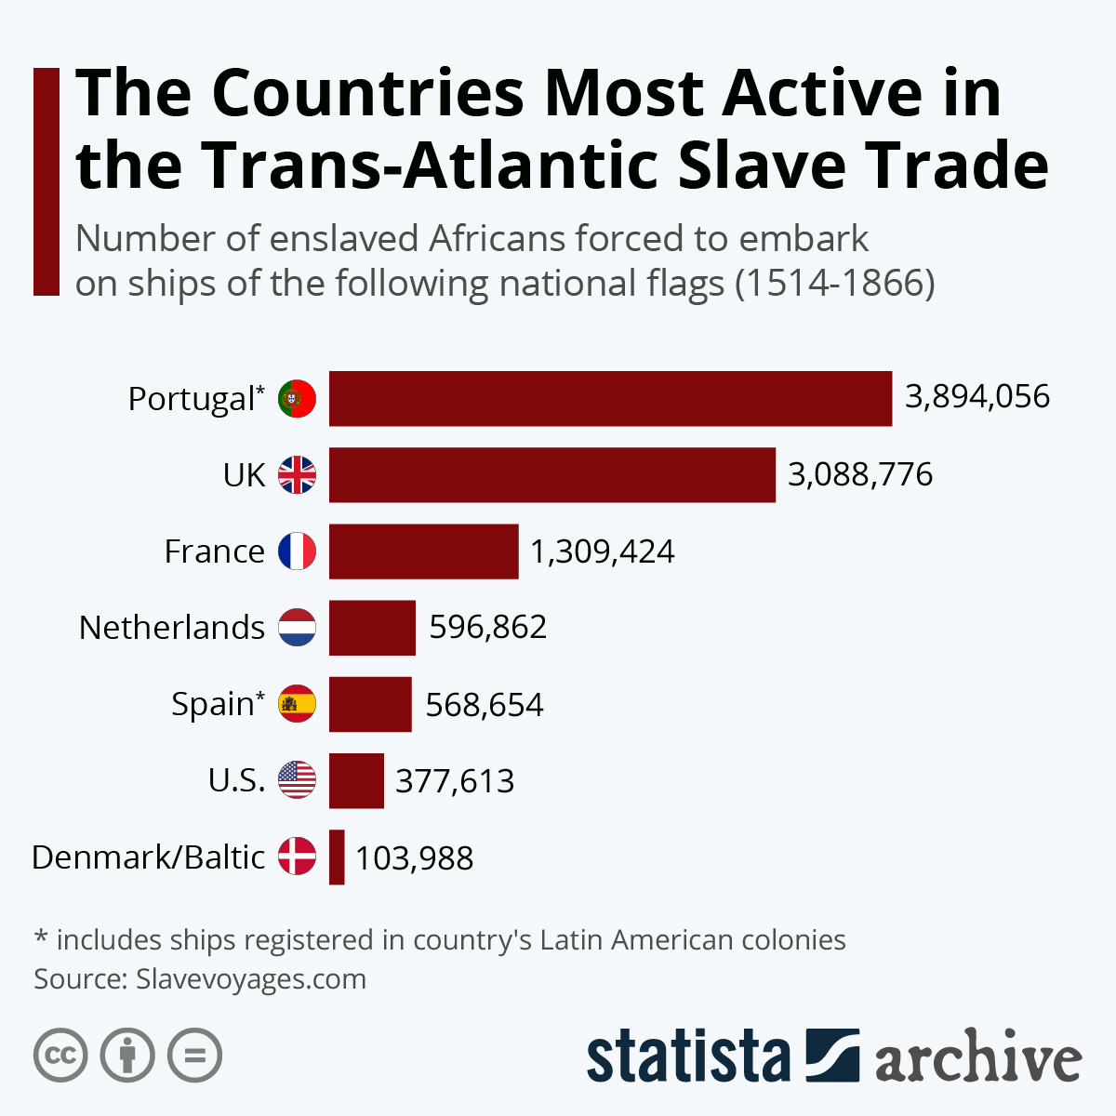
New Spain
With the subjugation of the indigenous people and the introduction of African slavery, Hispanics were born. Hispanics are the racial mixture of Caucasian, Indigenous, and African.

Slide 14
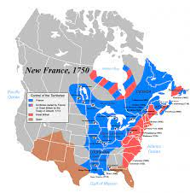
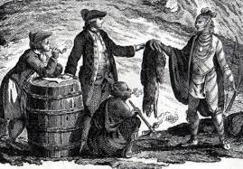
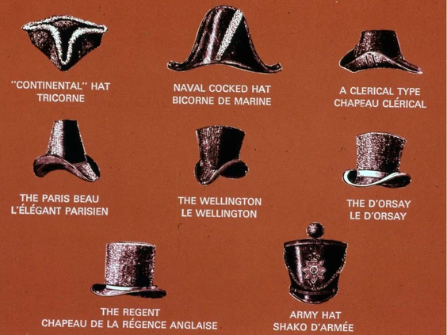
New France 1534-1763
In an effort to rival Spain, France began exploration in the early 1500’s and established it’s first colony in Quebec in 1608. French colonization would be very different than the Spaniards as they sought to befriend indigenous tribes as they engaged in the fur trade.
Samuel de Champlain
Jacques Cartier

Slide 15
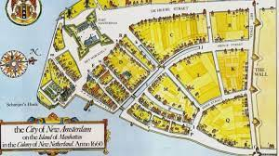
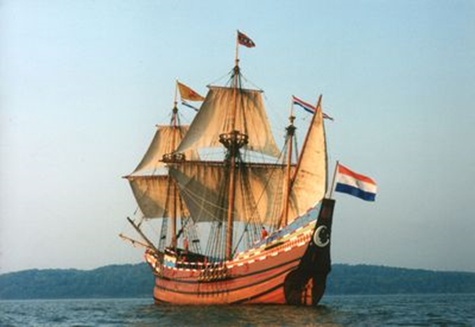
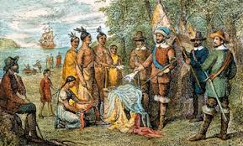
New Netherlands 1624-1664
The Dutch also got into the rivalry of exploration and colonization by establishing New Amsterdam on the tip of Manhattan island in 1624. The Dutch would establish a trading post for furs and other goods.
Dutch = Holland = Netherlands
Harlem, Brooklyn, Bronx, Manhattan, Yonkers are all Dutch names.

Slide 16
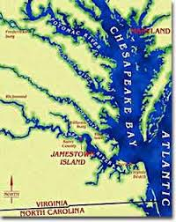
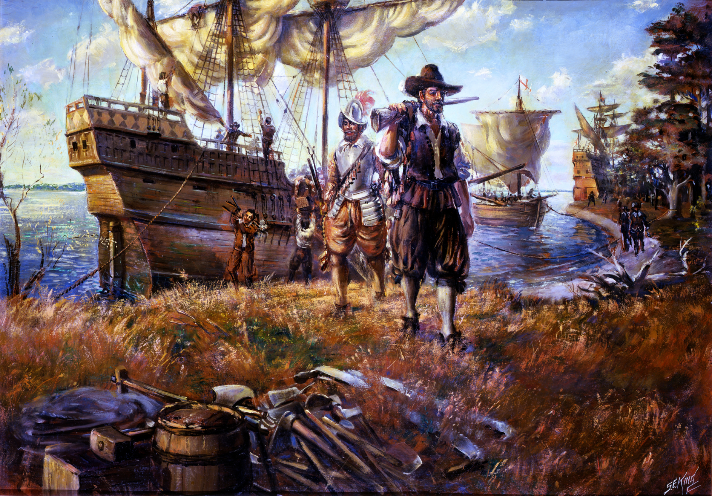
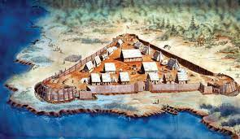
English Colonization
In 1588, England defeated the Spanish “Invincible” Armada. With Spain weakened, England was free to explore and colonize the Atlantic coast of North America. In 1607, Jamestown, Virginia became the first permanent settlement in the New World for England.

Slide 17
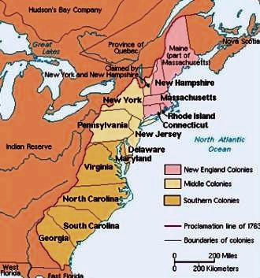
13 Colonies
Virginia (1607) New Hampshire
Massachusetts (1620) Massachusetts
New Hampshire (1623) Rhode Island
Maryland (1634) Connecticut
Connecticut (1635) New York
Rhode Island (1636) New Jersey
Delaware (1638) Delaware
North Carolina (1653) Pennsylvania
South Carolina (1663) Maryland
New Jersey (1664) Virginia
New York (1664) North Carolina
Pennsylvania (1682) South Carolina
Georgia (1732) Georgia

Slide 18
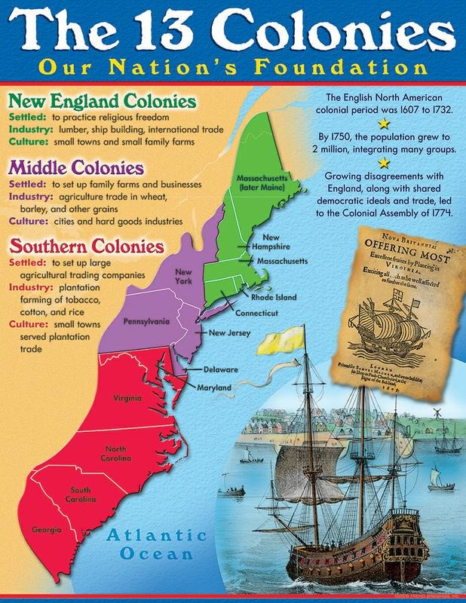
13 Colonies
With the success of Jamestown, more English colonies would develop, eventually leading to 13 Colonies. The colonies could be divided into three distinct regions:
New England = Northern Colonies
Mid-Atlantic = Middle Colonies
Southern = Southern Colonies

Slide 19
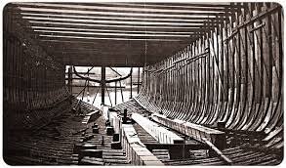
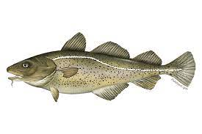
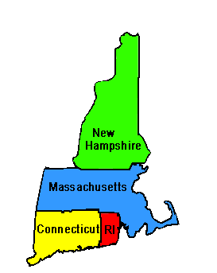
New England Colonies
The New England colonies were first settled by the Pilgrims or “Puritans” on November 11, 1620 in an effort to establish a Protestant religious order free from British persecution. Economically they were known for abundant forests, fur trading, and fishing. They provided many cultural contributions:
Boston is the largest city
Mayflower Compact (1620)
Thanksgiving (1621)
Religious Freedom
Public & Private Education
Town Hall Meetings
Ship building and commercial fishing
rocky soil and short growing season

Slide 20
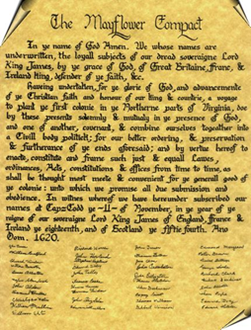
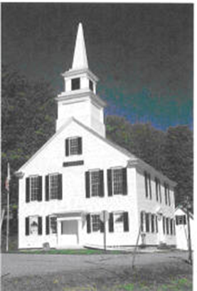
Plymouth Plantation (1620)

Slide 21
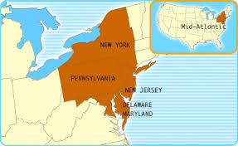
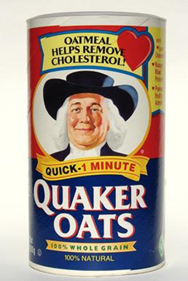
Mid-Atlantic Colonies
The Middle Colonies were first settled by the Dutch, Swedes, and Quakers. They were affectionately known as the “Bread colonies” and provided many cultural contributions:
Philadelphia and New York were the largest cities
Tolerance of indigenous and other religious groups.
Trade, banking, and commerce = $$$$
Freedom of Press

Slide 22
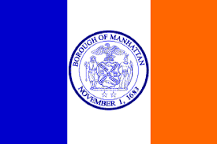
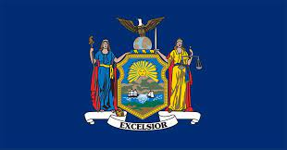
New York (1664)

Slide 23
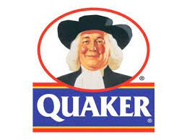
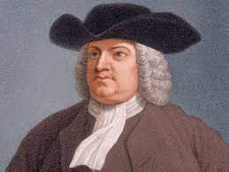
Pennsylvania (1682)

Slide 24
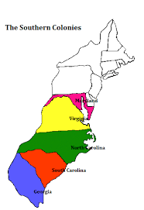
Southern Colonies
There were 5 Southern colonies and they were most known for having a agricultural economy with large plantations to support “cash crops.” They also provided many cultural contributions:
Cash Crops: Tobacco, Cotton, Indigo, Rice
Fertile soil, long growing season, hot climate
House of Burgesses (1619)
Indentured Servants and Slavery (1619)

Slide 25
Jamestown (1607)

Slide 26
Mercantilism
Mercantilism is an economic trading relationship between colonies and their Mother Country. It provided colonies with a guaranteed market to sell raw materials and England one of many markets to sell their finished goods to for profit.
Triangular Trade
Colonial manufacturing was discouraged

Slide 27
Salutary Neglect (1607-1763)
Salutary neglect was the British policy of not enforcing mercantile laws in exchange for colonist loyalty for the purposes of colonizing North America on the cheap. Under this policy, colonists had great freedom.
Colonists paid less in taxes than citizens in England.
Land was plentiful and cheap.
Colonies were allowed to create colonial legislatures and make their own laws.
Colonies were allowed to create their own cultural institutions
Examples: House of Burgesses, Mayflower Compact, New England Town Hall Meetings, Freedom of Press, Public Education.
Both England and the Colonies liked this arrangement.

Slide 28
French & Indian War (1754-1763)
A war between France and England over the Ohio River Valley. The fate of the continent would be determined by the victor. Native American tribes sided with the warring powers.
French & Indian War = 7 Years War
Algonquin & Huron sided with the French
Iroquois sided with the British
Lt. Colonel George Washington fought in the war as a British officer in the Virginia militia and received fighting experience along with many other colonists.
England won the war at the Battle of Montreal in 1761
The Treaty of Paris (1763) ended the conflict with England gaining all of Canada and all lands east of the Mississippi.
This war is considered a turning point in history. England won, but at a price!

Slide 29
French & Indian War (1754-1763)

Slide 30
Harmful Neglect (1763-1775)
England won the war, but at a heavy financial price – debt (140 mp). England will turn to its colonies to help pay for the war debt, and in doing so, will begin enforcing its mercantile laws causing many colonists to question their relationship with their mother country.
Harmful Neglect = The British policy of enforcing mercantile laws and placing the colonies under direct control.
Proclamation Line of 1763 – Restricted colonial movement west of the Appalachian Mountains to protect Native Americans.
Sugar Act (1764) – Lowered the tax on sugar, but tightened the enforcement of the law and cracked down on smuggling.
Stamp Act (1765) - Taxed all printed materials on paper from newspapers to playing cards. Required a stamp to show proof.
Declaratory Act (1766) - Declared that Parliament had the authority to tax the colonies without their consent.
Townshend Acts (1767) - Tax on lead, glass, paper, and tea. Authorized the issuance of Writs of Assistance (warrants without probable cause).
Tea Act (1773) – Lowered the tax on tea in an effort to protect the monopoly of the British East India Company.
Coercive Acts (1774) – More commonly referred to as the “Intolerable Acts” they sought to close the port of Boston after the Boston Tea Party and submit to the will of the King!

Slide 31
Proclamation of 1763

Slide 32
Harmful Neglect (1763-1775)
As a result of the many taxes and restrictions from Parliament on the 13 British Colonies, many colonists began to protest and boycott goods.
“No taxation without representation” became the rallying cry.
Sons of Liberty and other groups began to emerge and harassed tax agents and other British officials.
Samuel Adams and Paul Revere were members.
Most colonists’ efforts were largely successful.

Slide 33
Boston Massacre (1770)
On March 5, 1770, 5 Boston colonists were killed by British soldiers in an incident that would be called, “The Boston Massacre.”
Public sentiment was against England.
Soldiers stood trial with some being found guilty.
John Adams publicly defended them.
Paul Revere made the engraving

Slide 34
Boston Tea Party (1773)
In an effort to resist the Tea Act, members of the Sons of Liberty threw 342 chests of British East Indian Tea on December 16, 1773 into the Boston Harbor.
Dressed up as Mohawk Indians
This infuriated England
Parliament passed the Coercive Acts
to retaliate and punish Boston.

Slide 35
Coercive Acts (1774)

Slide 36
First Continental Congress (1774)
The Coercive Acts, led the American colonists to unite in defense of Bostonians and met in Philadelphia, Pennsylvania to discuss what they should do. This begins the origins of colonial unity.
12 of 13 colonies sent representatives.
Ben Franklin would be in attendance.
Recommended citizens of
Massachusetts to arm themselves.
Sent food and supplies to Boston.

Slide 37
Midnight Ride April 18, 1775
Paul Revere’s Ride Listen, my children, and you shall hear Of the midnight ride of Paul Revere, On the eighteenth of April, in Seventy-five; Hardly a man is now alive Who remembers that famous day and year. - Henry Wadsworth Longfellow

Slide 38
American Revolution (1775-1783)

Slide 39
Causes of the American Revolution
All wars can be summed up by the causes & effects of the conflict:
England’s change in policy from Salutary Neglect to Harmful Neglect that led to less economic and political freedom.
The Enlightenment – European movement of philosophy and science that sought to explain the universe through reason and logic.
Specific incidences of abuse carried out by England to control the colonies.
Battle of Lexington & Concord (1775) – The first shots fired by colonists against England.
Known as the “Shot Heard Round the World.” (April 19, 1775)

Slide 40
Lexington & Concord (1775)
Concord Hymn (1837) By the rude bridge that arched the flood, Their flag to April’s breeze unfurled, Here once the embattled farmers stood And fired the shot heard round the world. - Ralph Waldo Emerson

Slide 41
Second Continental Congress (1775)
With fighting breaking out at Lexington & Concord, the Second Continental Congress convened in Philadelphia, Pa.
13/13 colonies attended
Appointed a committee to draft a
resolution of independence.
Appointed George Washington as
General of the Continental Army.

Slide 42
Famous Patriots

Slide 43
Famous Loyalists

Slide 44
The Colonies vs. England
Strengths & Weaknesses: | 13 Colonies | England
Population | 2.8 million colonists | 12 million English
Manufacturing | Practically none | Highly developed and flourishing
Money | No money to support the war effort | Richest country in the world
Army | All volunteer forces – willing to fight, but poorly equipped | Large, well trained army, plus mercenary Hessians
Leaders | Few, but dedicated officers who believed in the cause | Many dedicated, experienced, educated, and abled officers
Geography | Familiar land with easy access to limited amounts of supplies | Strange land with long distance to base of supplies.
Cause | Fighting for independence and freedom | Fighting to keep their colonies in order

Slide 45
The Enlightenment “I Think, therefore, I Am!”
The intellectual inspiration for the American Revolution lay in the European Enlightenment which was a philosophical movement from 1600-1800 that sought to understand the universe through reason and logic.
John Locke – Two Treatise on Government (1690)
Jean Jacques Rousseau - The Social Contract (1762)
Voltaire – Candide (1759)
Adam Smith – The Wealth of Nations (1776)
Baron de Montesquieu – The Spirit of the Laws (1743)
Each contributed to the advancement of our modern day world through their writings. Many colonists read their works.

Slide 46
Common Sense (1776)
Common Sense was a pamphlet written by Thomas Paine who sought to persuade colonists to join the fight for independence.
Published in January 1776 and was a best seller.
Thomas Paine was an Englishman who immigrated to America.
Common Sense is considered an Enlightened piece of literature.
Criticized the mercantile relationship of England and its colonies.
One of the most influential books in American history.
Led to the writing of the Declaration of Independence.

Slide 47
Common Sense (1776)

Slide 48
Common Sense (1776)
“…Small islands not capable of protecting themselves, are the proper objects for kingdoms to take under their care; but there is something very absurd, in supposing a continent to be perpetually governed by an island. In no instance hath nature made the satellite larger than its primary planet, and as England and America, with respect to each other, reverses the common order of nature, it is evident they belong to different systems: England to Europe, America to itself…”
- Thomas Paine

Slide 49
Common Sense (1776)
“. . . Every thing that is right or reasonable pleads
for separation. The blood of the slain, the
weeping voice of nature cries, ’TIS TIME TO
PART. . . .”
— Thomas Paine, Common Sense

Slide 50
Declaration of Independence July 4, 1776
Written by Thomas Jefferson and edited by the Committee of Five, The Declaration of Independence is our founding document that sought to separate the colonies from Great Britain. It is a philosophical document that, like an essay, contains three parts:
Preamble – The intro that contains Enlightened ideas most influenced by John Locke.
“All Men are created equal”
Natural Rights: “Life, Liberty, & the Pursuit of Happiness”
Government gets its power from the “Consent of the governed” (the people)
Grievances – The body that lists the abuses the colonies have against the King of England.
“He” = King George III = Tyrant = Usurper = Despot = Oppressor and is blamed 27 times for assaults against the colonies.
Resolution – The conclusion that results in the unanimous declaration of independence by 13 colonies.
56 signatures from representatives of all 13 colonies
“We mutually pledge to each other our lives, fortunes, and our sacred honor.”
Note: unintentionally uses the name, “united States of America.” First time ever written on paper.

Slide 51
Declaration of Independence Thursday, July 4, 1776

Slide 52
Battles of the Revolution
Battle of Lexington & Concord, April 19, 1775 – “The Shot Heard Round the World.” The American Revolution begins in Massachusetts.
Battle of Trenton, December 26, 1776 – Christmas surprise attack in New Jersey that boosted colonial morale.
Battle of Saratoga (1777) – Turning Point American victory in New York that led to the Franco-American alliance.
Battle of Yorktown (1781) – British are defeated and surrender at Yorktown, Virginia. The fighting is over.

Slide 53
Lexington & Concord (1775)
Concord Hymn (1837) By the rude bridge that arched the flood, Their flag to April’s breeze unfurled, Here once the embattled farmers stood And fired the shot heard round the world. - Ralph Waldo Emerson

Slide 54
Battle of Trenton (1776)

Slide 55
Battle of Saratoga (1777)

Slide 56
Battle of Yorktown (1781)

Slide 57
Treaty of Paris (1783)
With the end of fighting at Yorktown, Virginia in 1781; time was needed to draw up the terms of peace between England and the United States. The Treaty was signed in Paris.
England officially recognizes American independence and American sovereignty.
The United States received all land east of the Mississippi River.

Slide 58
Treaty of Paris (1783)

Slide 59
The United States of America Independence Achieved

Slide 60
Essential Questions
What were the three regions of the British 13 North American colonies and what economic resources did each region provide England?
Identify and explain two lasting legacies of Jamestown, Virginia.
Identify and explain two lasting legacies of Plymouth, Massachusetts?
What was “mercantilism” and how did England benefit with it’s relationship to it’s colonies?
What was “Salutary Neglect” and why did both the colonies and England like it?
What led to the colonists’ slogan, “No Taxation without Representation?”
Why is the Declaration of Independence an important American and World document?
Explain each of the following people’s contribution toward the American Revolution: George Washington, Thomas Jefferson, Alexander Hamilton, Samuel Adams, and Benjamin Franklin.
Why are the battles of Lexington (1775), Saratoga (1777) and Yorktown (1781) important?

