Slide 1
School 16 Parent Workshop
Friday, June 18, 2021

Slide 2
Presented By
Debra Cantor, ENL Teacher
Molly Fitzpatrick, Reading Teacher
Diana Kalina, ENL Teacher

Slide 3
Agenda
Welcome
Introductions
Library Locations in Yonkers
Library Card Application
How to Access Books Online – Overdrive, Hoopla
Suggested Reading Booklists
How to Get Your Child Interested in Reading
Yonkers Summer Programs
Library Resources
Questions

Slide 4
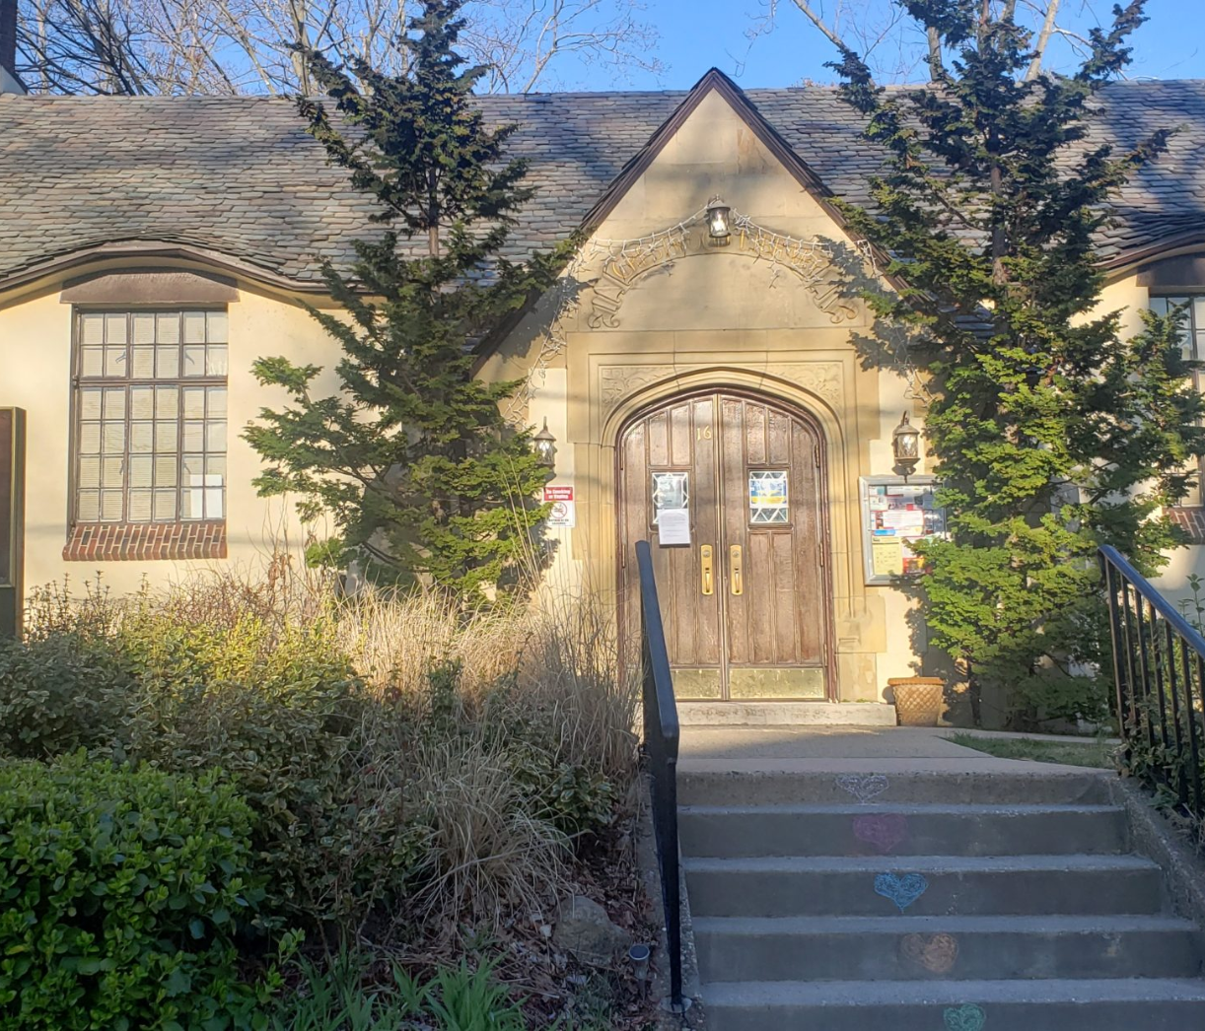
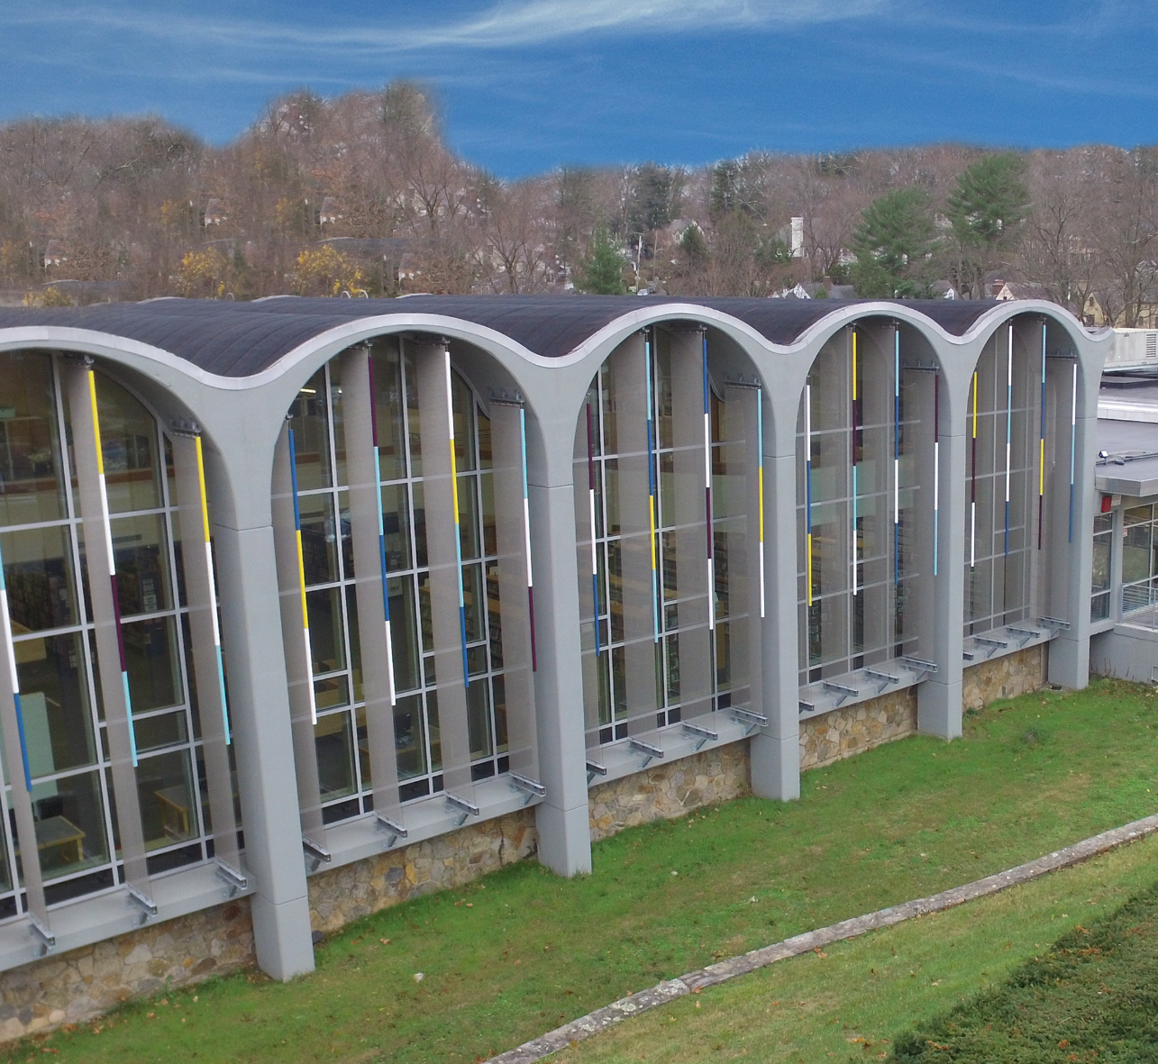
Libraries in Yonkers
Riverfront Library
1 Larkin Center, Yonkers, 10701
Grinton I. Will Library
1500 Central Park Ave., Yonkers, 10710
Crestwood Library
16 Thompson St., Yonkers, 10707

Slide 5
How to Apply for a Library Card
https://www.ypl.org/services/librarycard/
Apply in person OR online
Access to all branches in Yonkers
Online account to check out books
Ebooks & Audiobooks

Slide 6
How to Access Books Online
Westchester Library System- Apple and Android App
Digital library card- scanned from your smart phone
Search the catalog and digital collections.
Access your library account to renew items, manage holds, and more.
Find out about programs and services offered by the library.
Hoopla- Apple and Android App
Stream and download Movies, TV, Music Albums, eAudiobooks, eBooks, and Comics/Graphic novels.
Type Westchester Library System as your library.
Checkout 5 items per month.
Overdrive- Apple and Android App
Search, checkout & place holds on ebooks and audio books in the Overdrive Catalog.
Download content direct to the device
Listen to and read downloaded titles.
Early return now available on certain devices.

Slide 7
Barnes & Noble Summer Reading Program
https://dispatch.barnesandnoble.com/content/dam/ccr/pdf/2021/BN_Summer_Reading_21_Journal_English.pdf

Slide 8
How to Get Your Child Interested in Reading
Audiobooks
Model a love for reading
Read alouds/ storytime- daily
Crafts/ activities based on the books they read
Bring the books to life! - zoos, museums, planetariums, etc.
Read the book then watch the movie- discuss similarities & differences
Library Activities- Book Clubs, Storytime, Arts & Crafts
Cook- reading recipes
Incorporate into family customs and traditions- birthday gifts, seasonal books

Slide 9
Yonkers Summer Academy of Excellence
In-Person Instruction
Students currently in Prek-5
July 7- August 5, 2021
8:30 am -12:30 pm
Transportation for eligible students
Breakfast & lunch
Literacy, Numeracy, Social Emotional Support, Enrichment
Parent Academy
10 School Locations

Slide 10
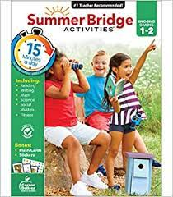
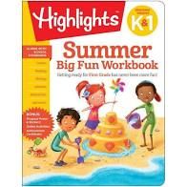
Summer Activity Ideas
Summer Slope
Yonkers Summer Academy of Excellence
Summer Bridge Activities
Activity Books
Scavenger Hunts
Picnics
Farmers Markets – different fruits and vegetables
Zoo, Museums – look for free days

Slide 11
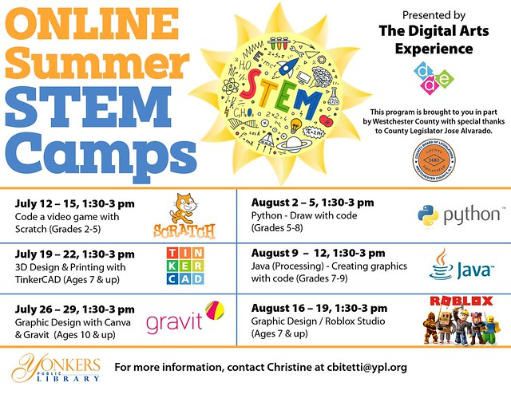
Library Resources
https://www.ypl.org/whats-happening-kids/
STEM Classes
Magic Shows
Crafts
Storytime
Book Clubs
FREE!

Slide 12
Questions

Slide 13
Thank You!
Thank you for your continued support this year!
Have a wonderful summer vacation!

